Slide 1
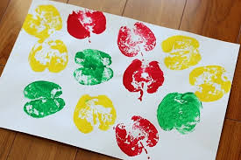
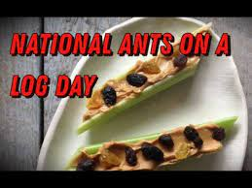
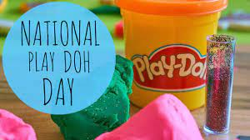
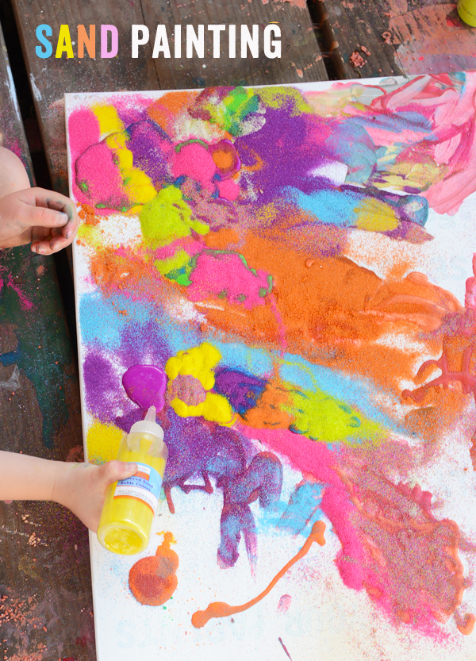
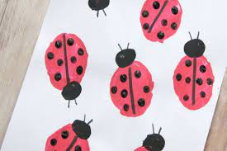
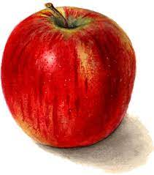
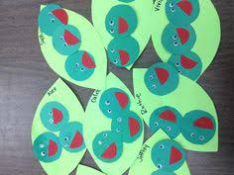
September 2024
Monday | Tuesday | Wednesday | Thursday | Friday
2 | PS2: Apple Prints | 4 APK: Chicka Chicka Palm Trees | 5
9 Bring your favorite teddy bear to school | 10 Make Ants on a Log | 11 wear Red, White & Blue | 12. | 13.
16. make homemade playdough | 17. PS3: Workout Wonder: I Can Move My Body To Music! | 18. | 19. | 20.
23. Infant 3 Ladybug Fingerprints | 24. | 25. | 26. Pre-K Still life Apples | 27. Little Green Peas Infant 1&2
30. Wear a Orange Shirt

