Slide 1





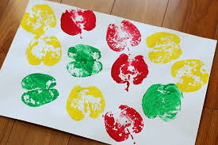




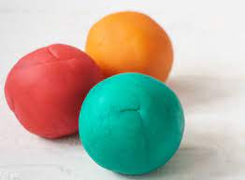

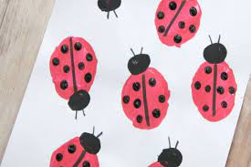
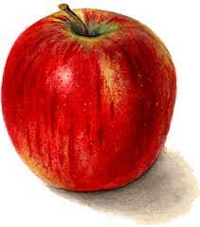
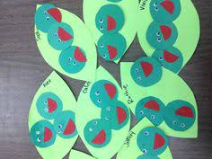
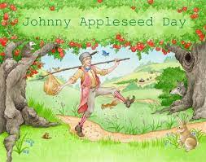




September 2023
Monday | Tuesday | Wednesday | Thursday | Friday
 |  |  | 1 | 2. National College Colors Day Wear your favorite College colors
4 | APK: Chicka Chicka Palm Trees | 6 | 7. PS2: Apple Prints | 8. Grandparent Appreciation Day 9:30-10:30 AM
11. Wear Red, White & Blue | 12. PS3: Workout Wonder: I Catch The Cat | 13. Toddlers : Making Circles W/ Playdough | 14. | 15.
Infant 3 Ladybug Finger Prints | 19 | 20. PS 2 Outdoor Activity Workout Wonder: Apple Around | 21 Pre-K Still life Apples | 22. Little Green Peas Infant 1&2
25 | 26. |  | 28. | 29. 6:30 PM-11:00 PM

