Slide 1




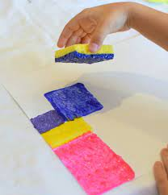
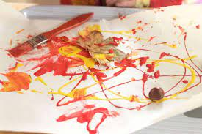



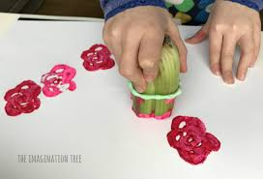


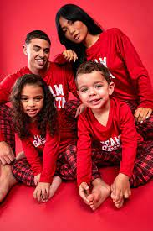
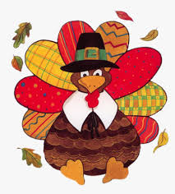
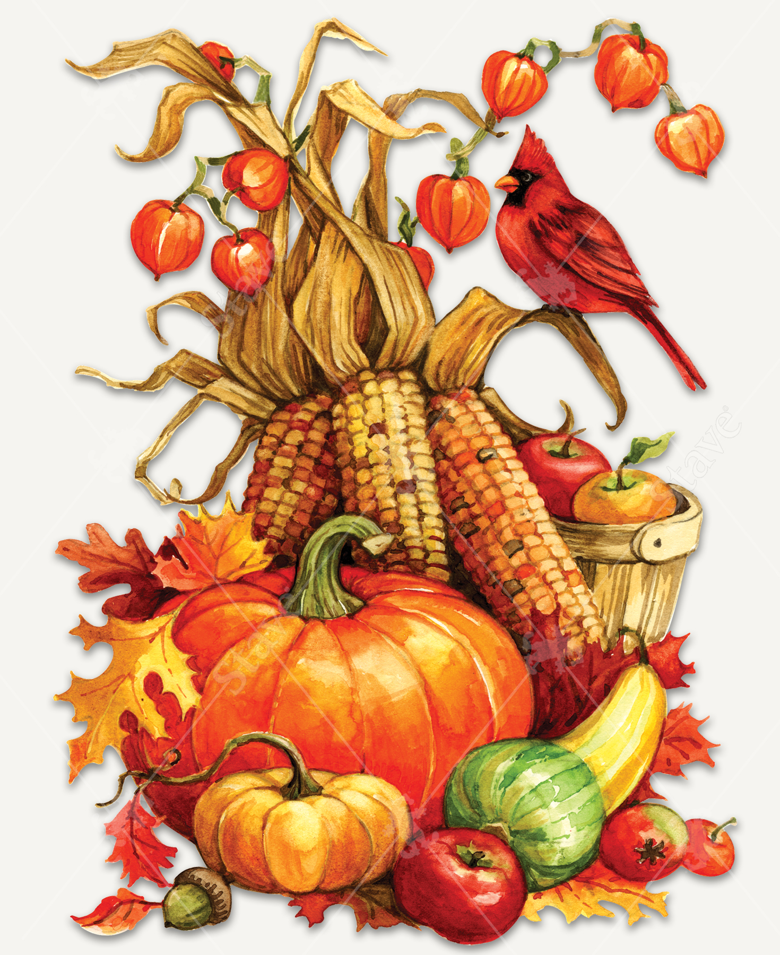
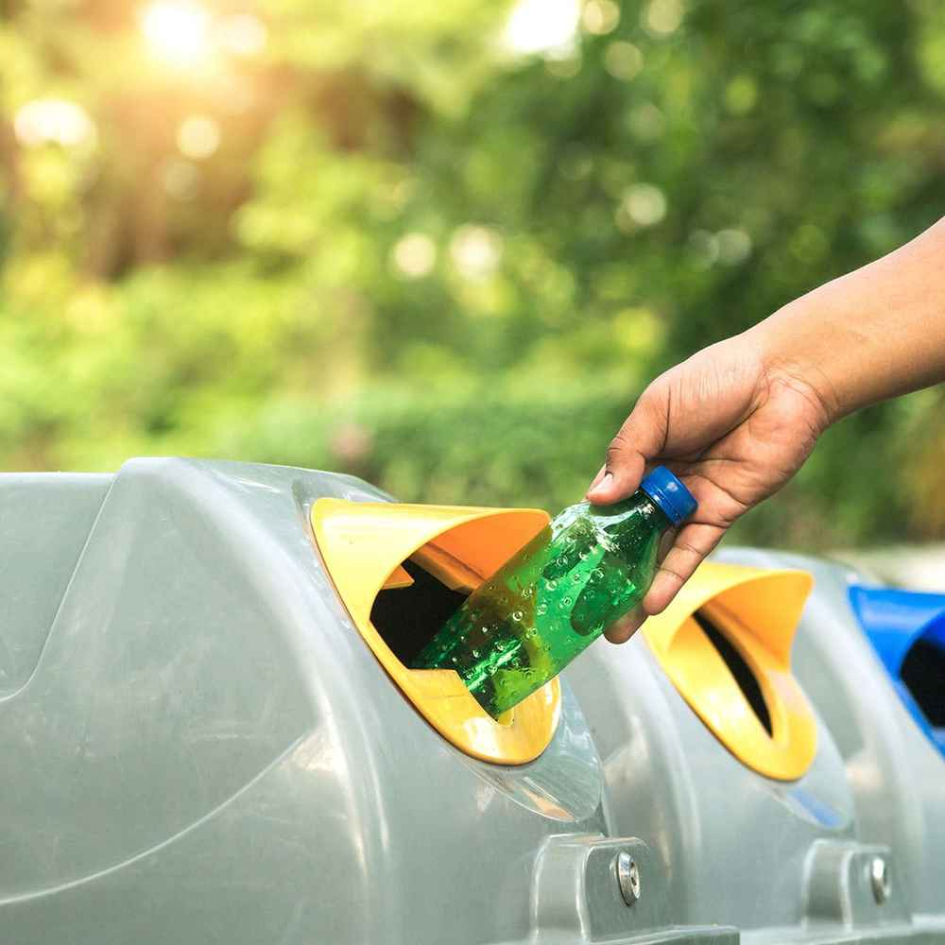
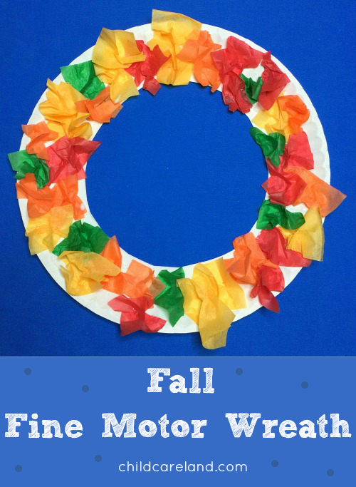
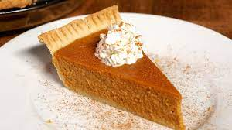

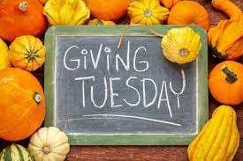
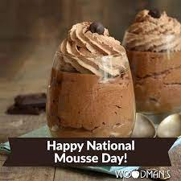
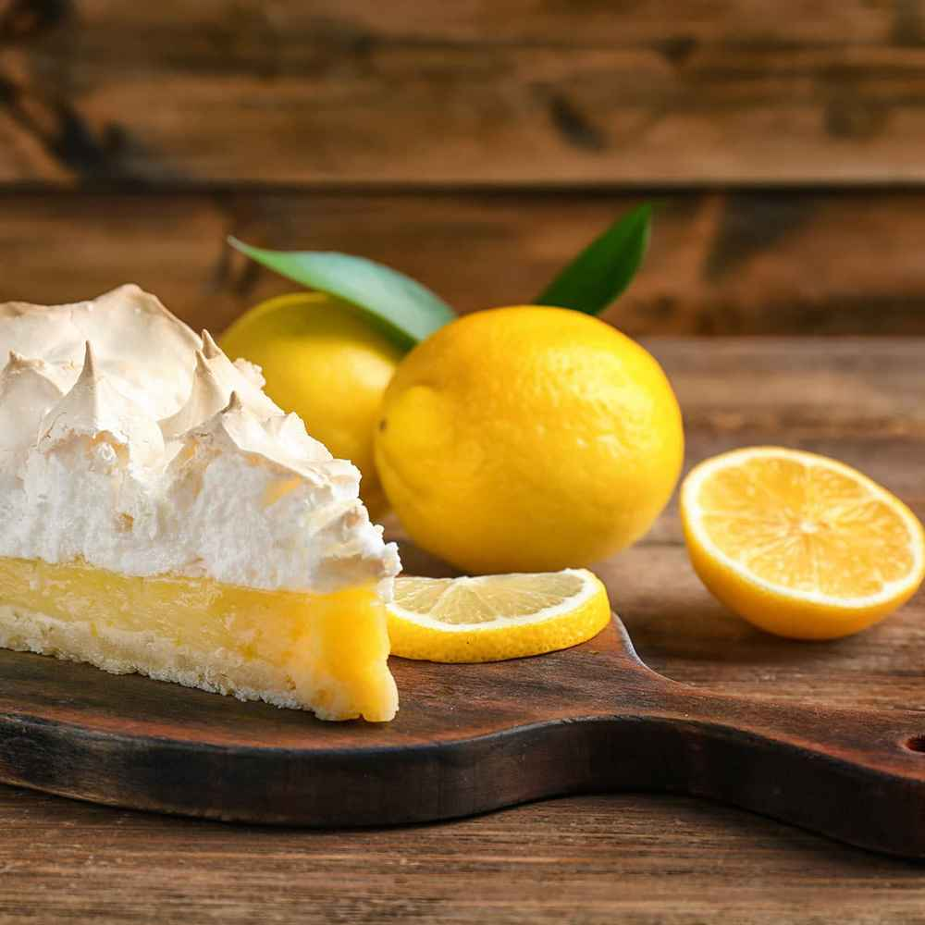
November 2023
Monday | Tuesday | Wednesday | Thursday | Friday
30. Soccer Shots 9:00 & 9:30 3yr-5yr olds | 31 | 1. Toddler Rectangle Sponge Stamping | 2. Infant 1&2 Art Activity Fall Colors Painting | 3
6 Toy Donation Drive Wear your favorite Orange shirt | 7 Infant 3 Art & Sensory Celery Prints | 8 Learning Lesson -PK Handwriting: Letter I | 9 World Freedom Day | 10 Veterans Day Celebration @9:30 AM RM 10 Wear Red , White & Blue
PS3 Corn Of Many Fall Colors | 14. National Family PJ Day | 15. National Recycling Day | 16 PS3 Tissue Paper Fall Wreath | 17 Children Thanksgiving Feast for Lunch
20 APK Learning Lesson Sight Word “brown” | 21 Pie With Parents At 3PM | 22 Closing Early At 3PM | 23 Closed | 24 Closed
27 PS2 Mini Reader "We Are Thankful" | 28 | 29 National Lemon Cream Pie Day | 30. | 1.

