Slide 1
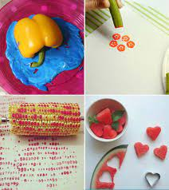
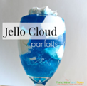
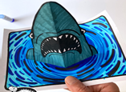
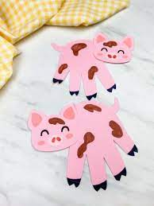
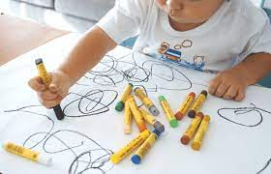
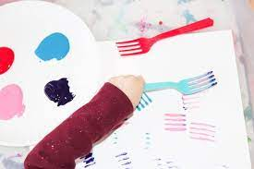
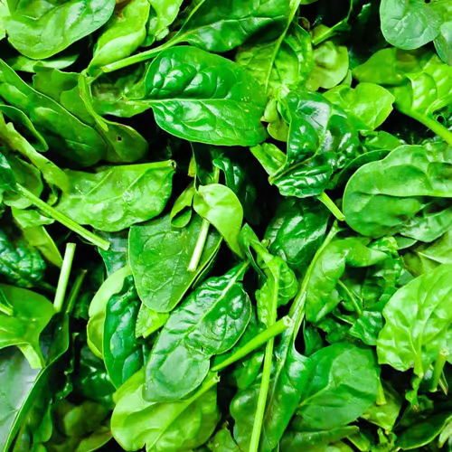
March 2024
Monday | Tuesday | Wednesday | Thursday | Friday
 |  |  |  | 1.
4. | 5. Pancakes for Snack | 6. PS3 Veggie Prints | 7. | 8.
11. Spring Break Around The World | 12. Spring Break Elemental Discovery | 13. Spring Break Bizarre Creature | 14 Spring Break Brick City | 15. Spring Break Shark Week
18. | 19. Infant 1&2 Fancy Pink Pigs | 20. Infant 3 Coloring With A Black Crayon | 21 Bring a picture of your puppy to share | 22. APK Key Rubbing Art
25. Fork Painting | 26. National Spinach Day | 27. PS2 Snake Sculptures | 28. Special Popsicle treat | 29. 6:30PM-11:00PM

