Slide 1




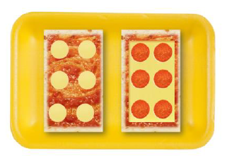









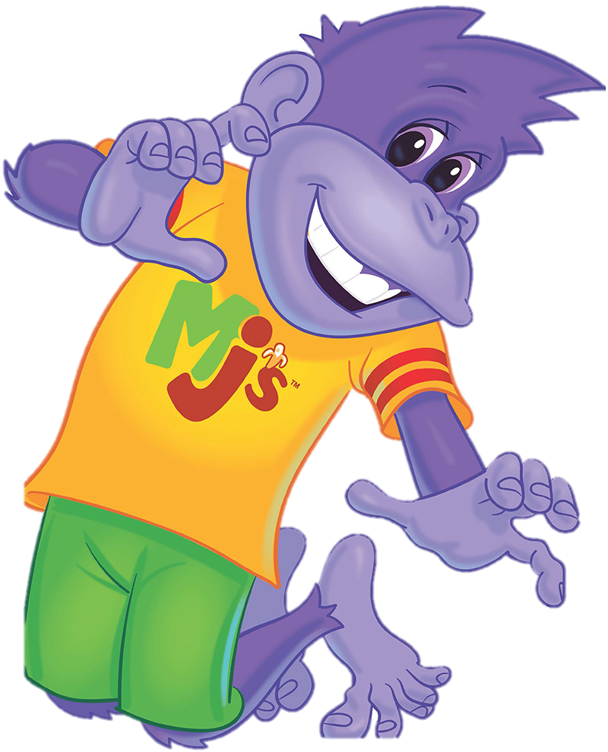











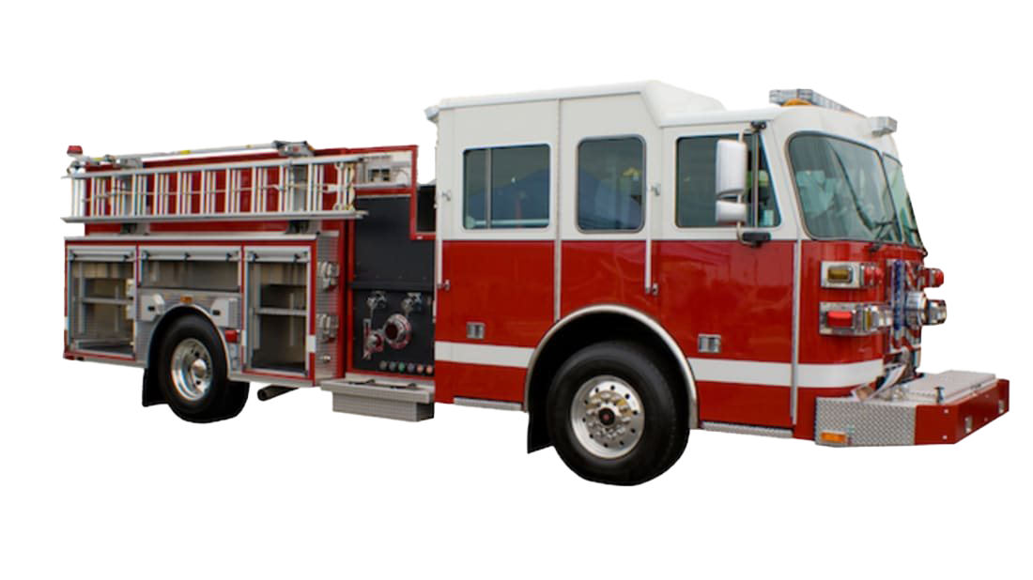










JULY 2024
Sunday | Monday | Tuesday | Wednesday | Thursday | Friday | Saturday
 | 1 | 2 | 3 | 4 | 5 | 6
7 | 8 | 9 | 10 | 11 | 12 | 13
14 | 15 | 16 | 17 | 18 | 19 | 20
21 | 22 | 23 | 24 | 25 | 26 | 27
28 | 29 | 30 | 31
NO SCHOOL
Happy 4th of July!
NO SCHOOL
Closed for Staff Development Day
Brick City
Brick Bites
Brick Buddy
Room 10:
Mason Skating Rink
Code Red
Room 9:
Monkey Joes
Room 10:
Katy Police Department
Spy Academy
Crumbled Mystery Mission
Room 10:
Room 9:
Room 10: Fulshear Fire Station Tour
Galactic Ring Toss
Movies
Journey to the Stars
Cosmic Confections
Room 10: Funtastik Lab
Room 9: Funtastik Lab
Room 10: Katy Christian Ministries
Shark Bite Relay
Shark Week
Shark Snackers
Room 10: Bowling @ Time Square
Room 9: Bowling @ Time Square
Hero Bootcamp
Super Snack

