Slide 1

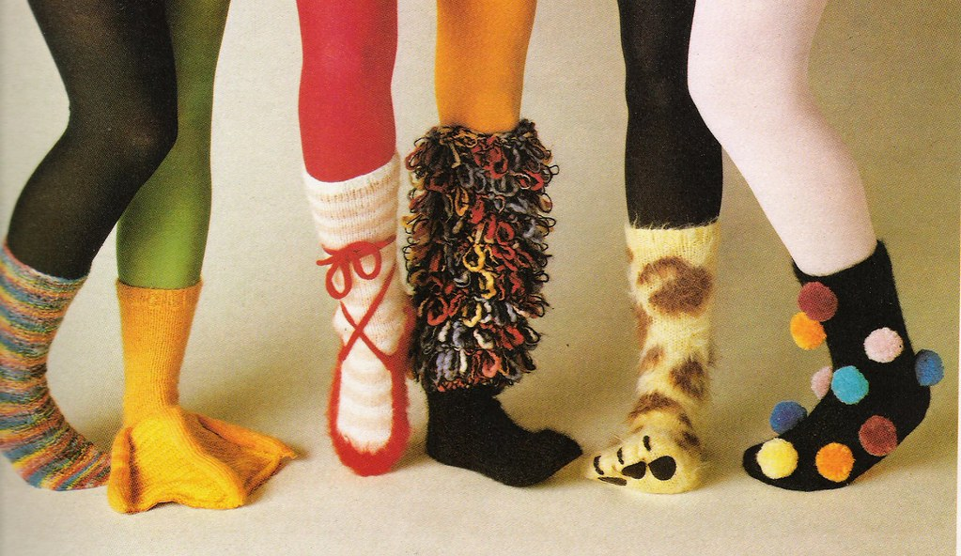

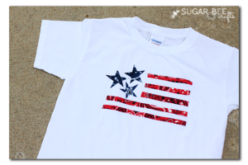
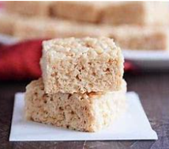
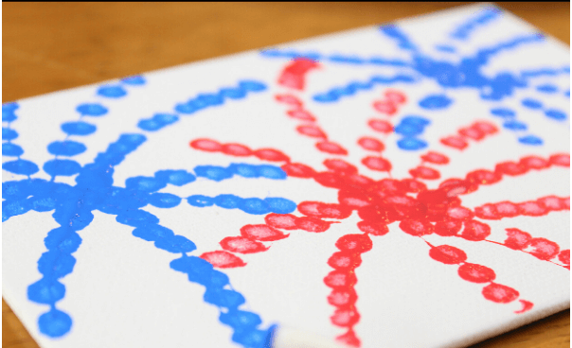
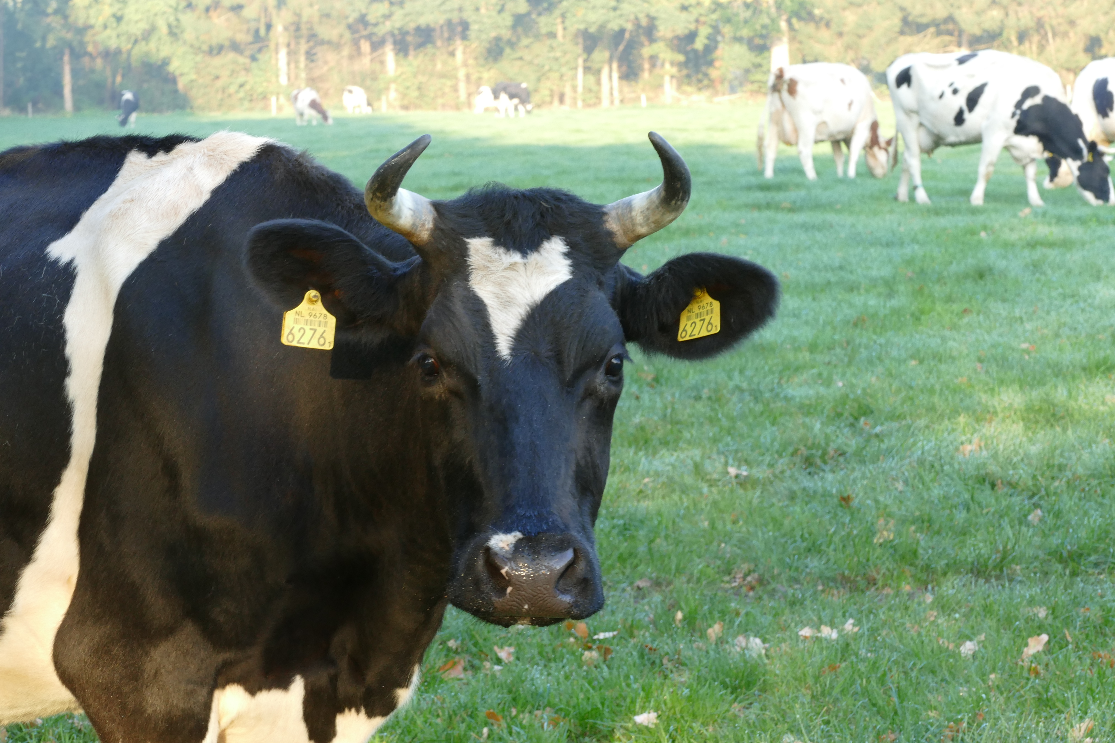

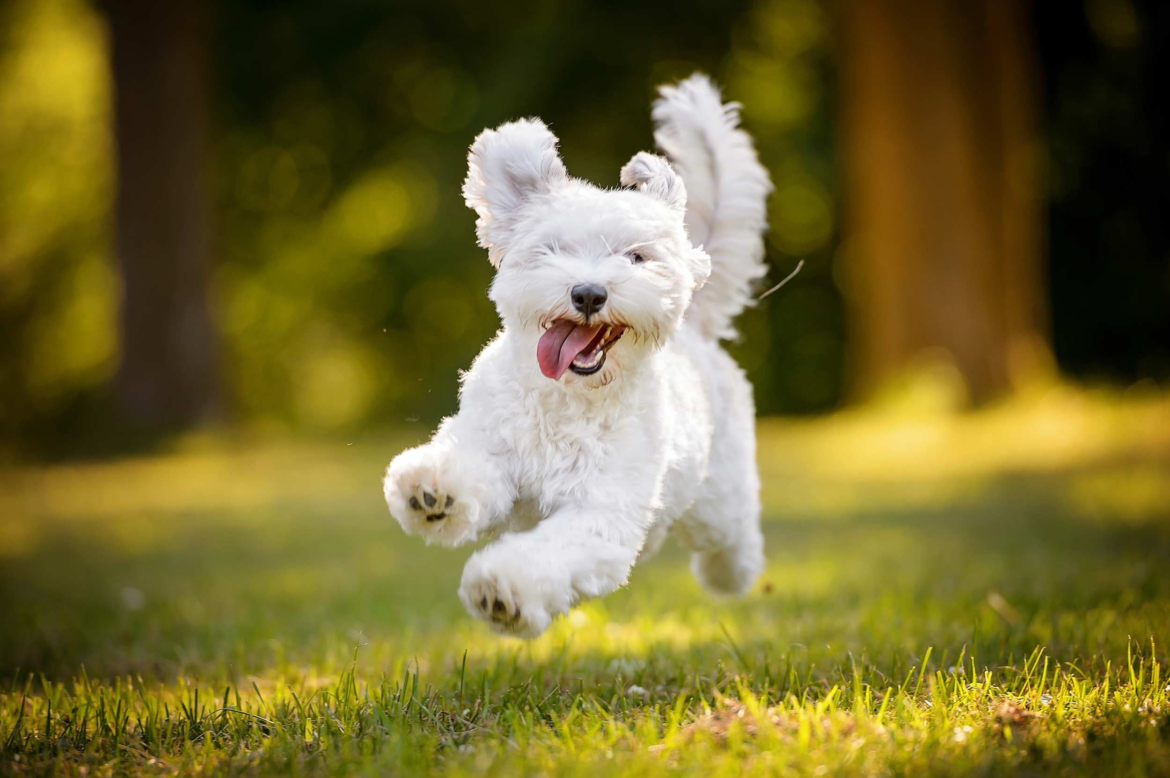


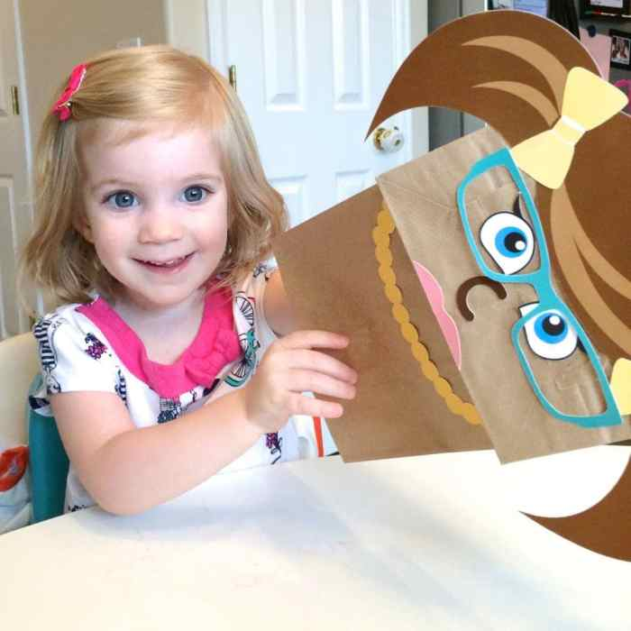












JULY 2024
Monday | Tuesday | Wednesday | Thursday | Friday
1 4th of July Art | 2 Making Brick Bites Room 9 & 10 | 3 Crazy Socks Day |  | 5 Wear Red, White & Blue Day
8 National Video Game Day | National Cow Day! Let’s all wear black & white and say Moo! | 10 Scavenger Hunt! Room 9 & 10 | 11 All American Pet Photo Day Bring a photo of your pet. | 12 Learn about Malala Day An Education Activist
15 Paper Bag Day Let’s make puppets! | 16 World Snake Day | 17 National Hot Dog Day | 18 Let’s all do a good deed today! | 19 Dino Footprint Cookies
22 Swimming Safety by FINS Rooms 7, 8, 9 and 10 | 23 Bring a photo of your “Gorgeous Grandma!” | 24 Wear a Crazy Hat Today | 25 Christmas in July?? | 26 Bring a photo of favorite Uncle or Aunt
29 | 30 International Friendship Day! Let’s Celebrate Friends Today | 31 Wacky Wednesday! Dress Wacky Today!

