Slide 2
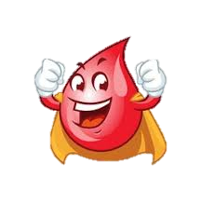
JANUARY 2022
Monday | Tuesday | Wednesday | Thursday | Friday
3 National Drinking Straw Day | 4 National Spaghetti Day | 5 National Bird Day | 6 Apple Tree Day Toddler Art: Puffy Paint Moon Art | 7
10 Infant 1&2 Sensory: Toes In Flour | 11 Learn Your Name in Morse Code | 12. Save a Life Blood Drive 1:30PM-5:00PM | 13 | 14 Wear a Silly Hat
17 We Have Dreams Too ! MLK Jr. Activity | 18 Preschool : Handwriting Letter P | 19. Make Popcorn Balls | 20 Quest: Can you create a snowflake | 21
24 | 25 Infant 3: Bubble Wrap Painting | 26 | 27 Make A Kazoo | 28 Parent’s Night Out 6:30-11 pm St. Jude Trike-a-Thon

