Slide 1
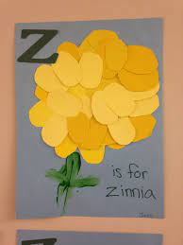
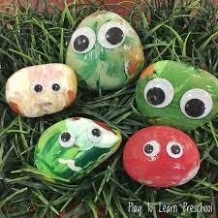
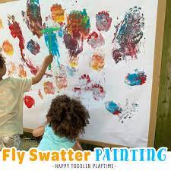
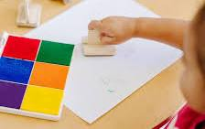
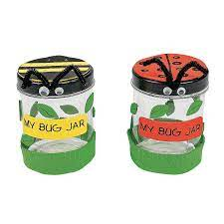
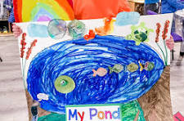
APRIL 2024
Monday | Tuesday | Wednesday | Thursday | Friday
1. | 2. | 3. | 4. Pre-K Spring Zinnia | 5.
8. Music Monday” Make & Take Home Instrument | 9. Snack Necklaces | 10.“Work Together” Wednesday | 11. “Artsy Thursday” Let’s create outdoor art! Rock Painting | Family Friday Family Picnic at 11:30AM
15. Graduation Pictures (Cap & Gown) at 9:30 A.M RM 8 & 9 | 16. Infant 1&2 I love Earth | 17. PS3 Creative Painting w/ Honey Dippers and Flyswatters | 18. Infant 3 Rainbow Oval Stamping | 19. APK My Insect Jar
22. PS2 My Pond Painting | 23. | 24. | 25. | 26. 6:30 PM-11:00 PM
Week of the Young Child

